Slide 1
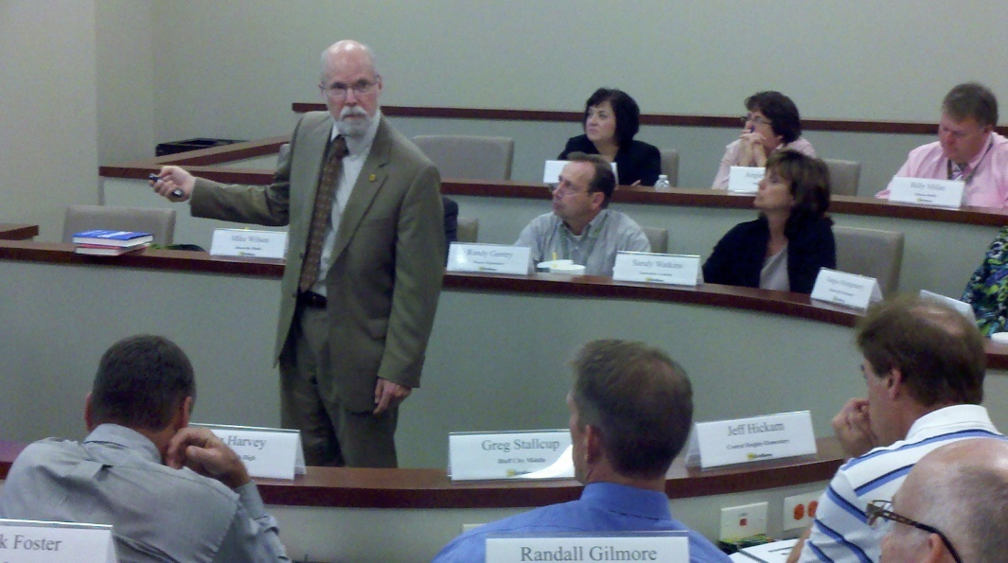



Identifying Your Best Opportunities to Deliver Your Products and Services to Your Brand Standard Every Time
Presented by:
Presented by: David McClaskey and David Jones
McClaskey Excellence Institute (www.McClaskeyExcellence.com)
Developed by: David J. McClaskey, President

Slide 2
EXTRAORDINARY
vs
ORDINARY

Slide 3
Rebranding
New name and logo – same great training content and consulting!

Slide 4

To inspire, enable, and support leaders to create extraordinary organizations through operational excellence
To help you take the next step toward excellence
Teach
Consult
Executive Coach
Keynotes

Slide 5
Staff
David McClaskey
David Jones
Katie Wood
Notes:
Member of Faculty for BEI.
Great Pride in having been able to contribute to Pal’s success over the past 14 years.
What do you want to take away that you can use back on your job?

Slide 6

















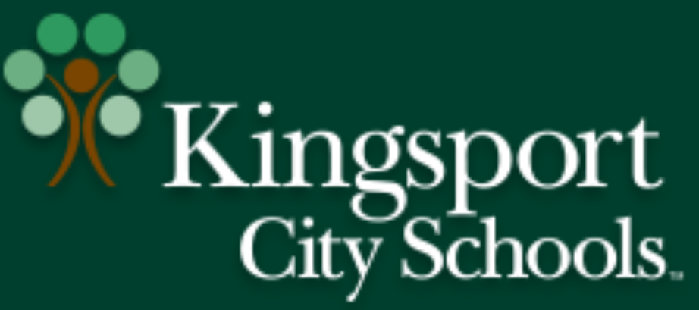









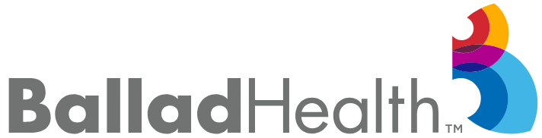








Slide 7

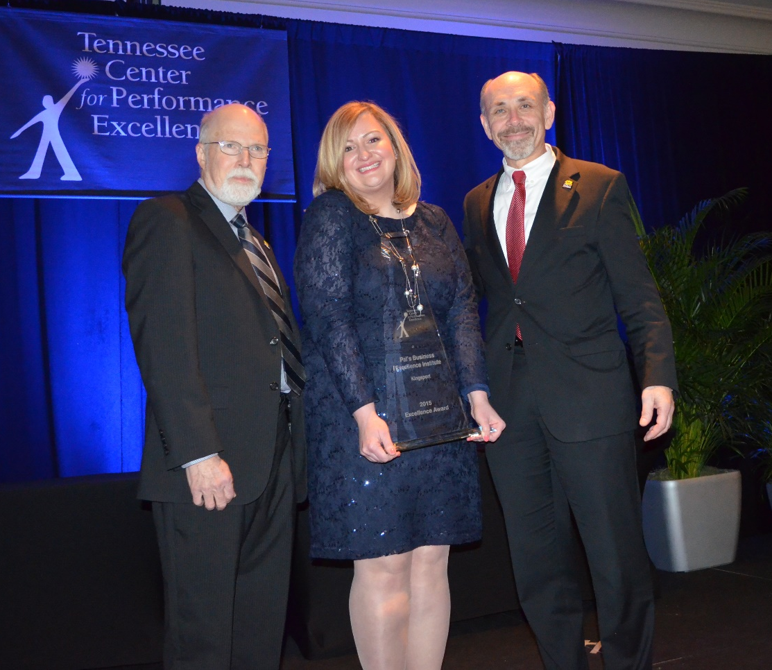
McClaskey Excellence Institute
Wins Top State Award for Performance Excellence in Tennessee

Slide 8
Operations Excellence
Operations Excellence is delivering your products, services, and environment to your brand standard every time.
Benefits: When your customers do not have to play a game of chance, and can 100% count that you will deliver your products and services to your brand standard every time, it leads to increased customer loyalty, positive recommendations and more repeat business.

Slide 9
Operations Excellence Benefits
How to make more money from what you are already paying for
How to make more money from your existing products and services, facilities, employees. .

Slide 10
Exercise
Impact of Operational Excellence on your business
How much more business (% increase) could your organization do if your organization produced your products and services to brand standard every time? (10% more; 50% more, etc.)
Your Answer: ____%
Estimated increase in revenue: $________

Slide 11
Financial Impact
If you consistently meet key customer requirements by delivering your products and services to your brand standard, expect your sales to be significantly better than operations that just meet the industry average.
25-300%

Slide 12




Example of Financial Impact of Operations Excellence:
The Only Two Baldrige Winning Restaurants:
Pal’s Sudden Service: 2001 Baldrige Winner
has 4 times (400%) the repeat business of its competitors.
K&N Management: 2010 Baldrige Winner
has 3 times (300%) the revenue of similar restaurants

Slide 13
Improving Your Operations Excellence
July 22, 11-12 Eastern: Identifying Your Best Opportunities to Deliver Your Products and Services to Your Brand Standard Every Time: Your Role is to find the next step you want to take and then take it!
Aug 6, 11-12 Eastern: Turning Improvement Opportunities into a Plan for Success: Develop a project plan for your selected project.
Aug. 20, 11-12 Eastern: Tools to Improve Your Key Processes: Tools to help you improve.

Slide 14
Objective of this Webinar:
Objective: To work together to help you select your next step toward excellence
Your Role: Find the next step you want to take and then take it!
Instructor’s Role: Provide an easy to use process to identify an improvement project to improve your existing products and services

Slide 15
The Funneling Effect
All Possible Improvement Areas
Opportunities
Projects
Implement Action Plans and Get Results
©2020 by McClaskey Excellence Institute. All Rights Reserved. www.McClaskeyExcellence.com

Slide 16
Example: Selecting Your Opportunity to Improve
Key Products and Services | Key Customers | Key Customer Requirements (KCR) | Measures | How Well Meeting KCR 10 – great 1- Needs a lot of improvement | Opportunity Selected
Food | Consumers | Quality | Complaints/ Audits | 8
Service |  | Accurate | Complaints | 6 | Selected
 |  | Fast | Average transaction time | 6
 |  | Friendly | Customer evaluations | 9
 |  | Value | Repeat business | 8
Notes:
To help you with your job of prospecting – we want to use two tools
1) This LOG for recording GEMS. If you hear something that you think is important, worth sharing. --- Ticket to breaks.
2) This LOG for recording your action ideas.
It’s one thing to learn something
Someone has said, you don’t know what you are thinking until you write it down.
You have a copy of this page on your table. Keep it handy – use it – Ticket for Lunch and Tour.
One other thing you will want to do – QUESTIONS for our Q&A session with O/O

Slide 17
Selecting Your Opportunity to Improve
Key Products and Services | Key Customers | Key Customer Requirements (KCR) | Measures | How Well Meeting KCR 10 – great 1- Needs a lot of improvement | Opportunity Selected
Notes:
To help you with your job of prospecting – we want to use two tools
1) This LOG for recording GEMS. If you hear something that you think is important, worth sharing. --- Ticket to breaks.
2) This LOG for recording your action ideas.
It’s one thing to learn something
Someone has said, you don’t know what you are thinking until you write it down.
You have a copy of this page on your table. Keep it handy – use it – Ticket for Lunch and Tour.
One other thing you will want to do – QUESTIONS for our Q&A session with O/O

Slide 18
Describing the Improvement Project
Project Name
Project Objective | Project Description
Measure(s) | From: 2019 Baseline or current state | To: Target | Current Status

Slide 19
Describing the Improvement Project
Projected Intangible Value of Project | Projected Tangible Value of Project

Slide 20
Describing the Improvement Project
Project Name: 65% | Reduce errors in sandwiches during the lunch rush
Project Objective | Project Description
By Sept. 15, reduce complaints and improve inspection scores during the lunch rush to the desired target. | Each sandwich has precise standards that have to be met at the 100% level for the sandwich to be 100% to the brand standard. Some have 10-20 standards. Complaints include any product left out of the order during the lunch rush in addition to any food related complaint for that item.
Measure(s) | From: 2019 Baseline or current state | To: Target | Current Status
Complaints (sandwiches during the lunch rush) | 5/week | 1/week
Inspection Scores on sandwich accuracy of making the product to the brand standard | 65/100 | 95/100
Repeat business due to improved sandwich accuracy | 65% | 70%

Slide 21
Describing the Improvement Project
Projected Intangible Value of Project | Projected Tangible Value of Project
Reduced labor and hassle due to sandwiches not being made 100% to the brand standard | Improved repeat business and reduced waste due to improved accuracy from 65% to 70% is worth $35,000 per year.

Slide 22
Next Steps in Partnering Together
By July 30:
  Select your opportunity to improve your products and services to brand standard (complete worksheet).
  Turn the opportunity into a specific project to improve your products and services being delivered to your brand standard every time. Use the worksheet to describe the project, its objective, and measure.
To get the slides and the Select Your Opportunity and Charter forms, go to:
    McClaskeyExcellence.com; then click on webinar page
Determine if you are eligible for free McClaskey Excellence Institute individual consulting
Put the Aug. 6 and Aug. 20 (11-12 Eastern Time) free workshops on your calendar.
Notes:
Now let’s start looking at HOW Pal’s has achieved results like these – results that are clearly best in class - world class.
After “starting with the end in mind” and Category 7 Results, on our map we move back to the beginning and Category 1 – Leadership.
John Maxwell (world’s premier spokesman on Leadership) says that everything “rises & falls” on Leadership. Like the level of water in a lock on a canal.
I like the way Maxwell puts it when he talks about leaders seeing further, sooner, and more possibilities.

Slide 23

Make more money with less hassle!
Achieving World Class Results: Proven Path from Ordinary to Extraordinary
Lean: Get rid of waste and non-value adding activities
Spectacular Customer Service: Consistently friendly service that delights customers and brings them back
Do private and custom classes as well as public classes and consulting

Slide 24
Want to Learn More:
www.McClaskeyExcellence.com
423-914-2447
DavidMcClaskey@McClaskeyExcellence.com

